Slide 1
Wine Quality Prediction: A Data Science Approach
Anshuman 22scse1420049
Gaurav 22scse1420035
Bharat Sharma 22scse1420108

Slide 2

INTRODUCTION
What is wine quality prediction? A process of using data science techniques to predict the quality of wine based on various factors.

Slide 3

Why is it important? Helps winemakers improve production processes. Assists consumers in making informed choices. Provides valuable insights for the wine industry.

Slide 4
The attributes commonly used in wine quality prediction are: Fixed Acidity: The amount of non-volatile acids in the wine, primarily tartaric acid. Volatile Acidity: The amount of acetic acid in the wine, which can give it a vinegar-like taste if present in high amounts. Citric Acid: A preservative that adds freshness and flavor to wines. Residual Sugar: The amount of sugar remaining after fermentation. Chlorides: The amount of salt in the wine. Free Sulfur Dioxide: A preservative that prevents microbial growth and oxidation. Total Sulfur Dioxide: The total amount of free and bound forms of sulfur dioxide. Density: The density of the wine, which is related to its alcohol content and sugar level. pH: A measure of the acidity or alkalinity of the wine. Sulphates: A wine additive that contributes to sulfur dioxide levels and acts as an antimicrobial and antioxidant.

Slide 5
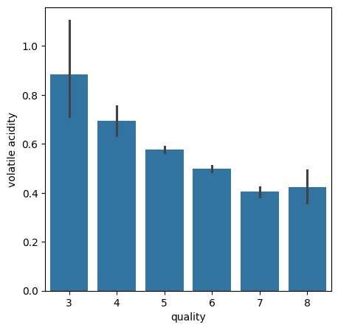

Slide 6
Data analysis

Slide 7
Data analysis

Slide 8
Training process: Splitting data into training and testing sets Training the selected models on the training data Evaluating model performance on the testing data using the chosen metrics

Slide 9
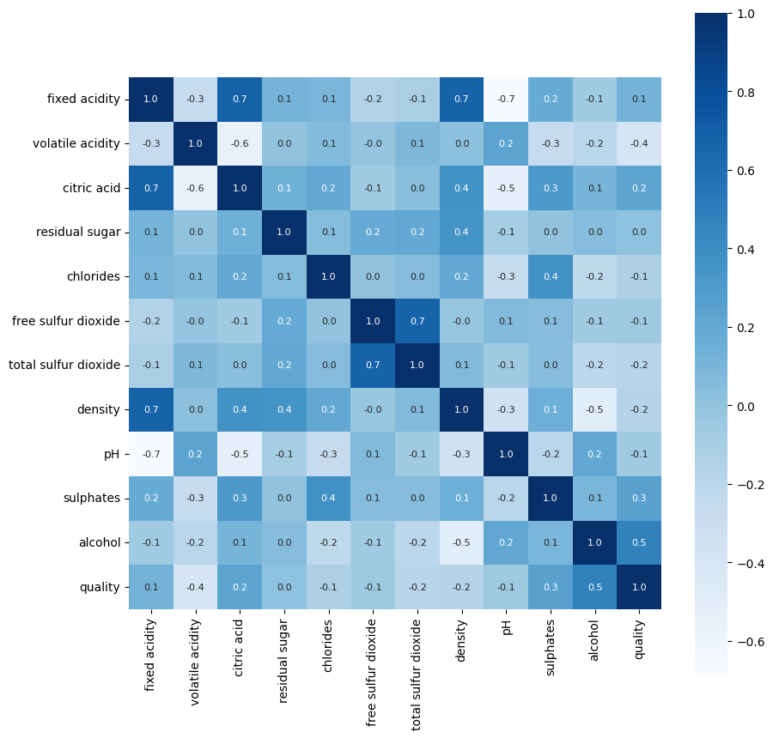
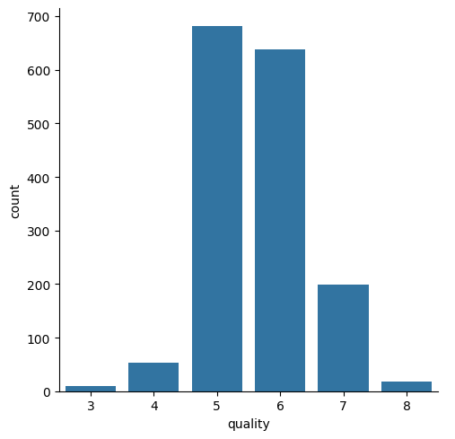
Data analysis

Slide 10
Thankyou

Slide 11
Source Code
Datasets
Ctrl + click to follow link :
Code review
Thankyou

